Slide 1
Neutronics Parameters for Preferred Chamber Configuration with Magnetic Intervention
Mohamed Sawan
Ed Marriott, Carol Aplin UW Fusion Technology Inst.
Rene Raffray
UCSD
HAPL Project Meeting UW-Madison October 22-23, 2008

Slide 2
Blanket Configuration
Top Blanket:
5 m above target
4.5 m outer radius
0.45 m inner radius
Bottom Blanket:
5.2 m below target
3.2 m outer radius
0.45 m inner radius
Side Blanket:
4.5 m radius
13 m height
5 m above target
8 m below target
Blanket
Magnet
Shield

Slide 3
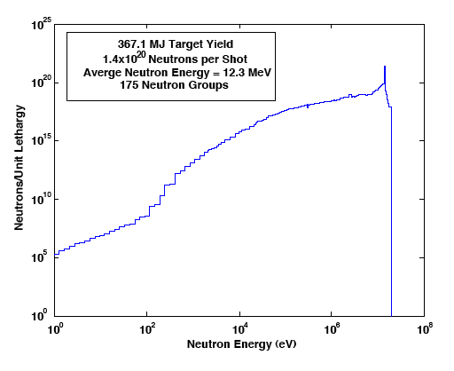
Neutron Wall Loading Distribution
(Top and Bottom Blankets)

Slide 4
Neutron Wall Loading Distribution
(Side Blanket)
Peak Neutron Wall Loading is 5.4 MW/m² in side blanket at target level

Slide 5
Blanket Design Options
Two blanket design options considered with low electrical conductivity SiC_{f}/SiC composite structure (required for dissipating the magnetic energy resistively)
LiPb/SiC
Flibe/Be/SiC
With Flibe a 1 cm thick Be insert is attached to back wall of FW coolant channel

Slide 6
Nuclear Design Requirements
Tritium self-sufficiency
Overall TBR >1.1
Breeding blanket coverage lost by the two point cusps is 0.4%
Breeding blanket coverage lost by 40 beam ports is 0.7%
Total breeding blanket coverage lost is negligible 1.1%
Shield and VV are lifetime components
Peak end-of-life radiation damage <200 dpa
Magnet is lifetime component
Peak fast neutron fluence <10¹⁹ n/cm² (E>0.1 MeV)
Peak insulator dose <10¹⁰ Rads
Vacuum vessel is reweldable
Peak end-of-life He production <1 He appm

Slide 7
Dimensions That Satisfy All Nuclear Design Requirements
 | Flibe Blanket | LiPb Blanket
Blanket Thickness (cm) | 100 | 80
Lithium Enrichment | 7.5% Li-6 | 10% Li-6
Magnet Shield Thickness (cm) | 25 | 45
Vacuum Vessel Thickness (cm) | 10 | 10

Slide 8
Tritium Breeding
 | Flibe Blanket | LiPb Blanket
Local TBR | 1.204 | 1.217
Top Blanket Contribution to TBR (12.57% coverage) | 0.151 | 0.153
Bottom Blanket Contribution to TBR (7.16% coverage) | 0.086 | 0.087
Side Blanket Contribution to TBR (79.18% coverage) | 0.953 | 0.964
Overal TBR | 1.190 | 1.204

Slide 9
Nuclear Heating
 | Flibe Blanket | LiPb Blanket
Peak Nuclear Heating in Blanket (W/cm³) SiC Be Breeder | 28 33 41 | 28 -- 80
Blanket Nuclear Energy Multiplication | 1.232 | 1.168
Top Blanket Nuclear Heating (MW) (12.57% coverage) | 212.4 | 201.4
Bottom Blanket Nuclear Heating (MW) (7.16% coverage) | 121.0 | 114.8
Side Blanket Nuclear Heating (MW) (79.18% coverage) | 1338.0 | 1268.9
Total Blanket Nuclear Heating (MW) | 1671.4 | 1585.1

Slide 10
Peak Damage Parameters in Blanket
 | Flibe Blanket | LiPb Blanket
Peak SiC Atomic Displacements per FPY C Sublattice (dpa/FPY) Si Sublattice (dpa/FPY) Average in SiC (dpa/FPY | 40 42 41 | 83 63 73
Peak SiC Helium Production per FPY C Sublattice (appm/FPY) Si Sublattice (appm/FPY) Average in SiC (appm/FPY) | 7,314 2,172 4,743 | 7,059 1,957 4,508
Peak SiC Hydrogen Production per FPY C Sublattice (appm/FPY) Si Sublattice (appm/FPY) Average in SiC (appm/FPY) | 4 3,862 1,933 | 4 3,512 1,758
Peak SiC Burnup per FPY C Sublattice (%/FPY) Si Sublattice (%/FPY) Total in SiC (%/FPY) | 0.32% 0.60% 0.92% | 0.29% 0.54% 0.83%

Slide 11
Peak Damage Parameters in Shield, Magnet, and VV
 | Flibe Blanket | LiPb Blanket | Design Limit
Peak EOL Shield Damage (dpa) | 0.04 | 3.6 | 200
Peak EOL Magnet Fast Neutron Fluence (n/cm²) | 1.03x10¹⁸ | 2.84x10¹⁷ | 10¹⁹
Peak EOL magnet insulator dose (Rads) | 3.39x10⁹ | 4.32x10⁹ | 10¹⁰
Peak EOL VV He production (appm) FS SS | 0.12 2.9 | 0.50 487 | 1 1

Slide 12
Summary and Conclusions
All neutronics requirements can be satisfied with a Flibe/Be/SiC or a LiPb/SiC blanket in HAPL with the present magnetic intervention configuration
Tritium self-sufficiency can be achieved for both blankets with overall TBR >1.1
~5% higher blanket nuclear heating obtained with Flibe
Peak dpa values in SiC are ~80% higher in LiPb blanket but peak gas production and burnup values are ~10% lower
The shield is lifetime component and magnets are well shielded for both blanket design options
The vacuum vessel is reweldable if it is made of ferritic steel
If austenitic SS VV is used, it will be difficult to meet rewelding criterion with LiPb blanket while rewelding will be possible with Flibe blanket if thickness is increased by ~10 cm

